Slide 1
Lecture
Median and Selection

Slide 2
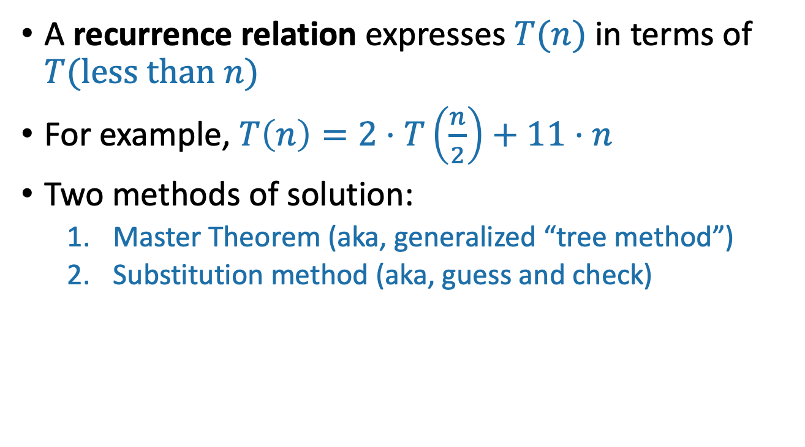
Last Time: Solving Recurrence Relations
A recurrence relation expresses $T(n)$ in terms of $T(less than n)$
For example, $T\left(n\right)=2⋅T\left(\frac{n}{2}\right)+11⋅n$
Two methods of solution:
Master Theorem (aka, generalized “tree method”)
Substitution method (aka, guess and check)

Slide 3
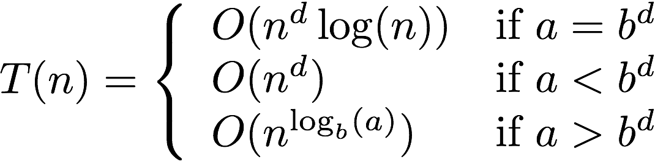
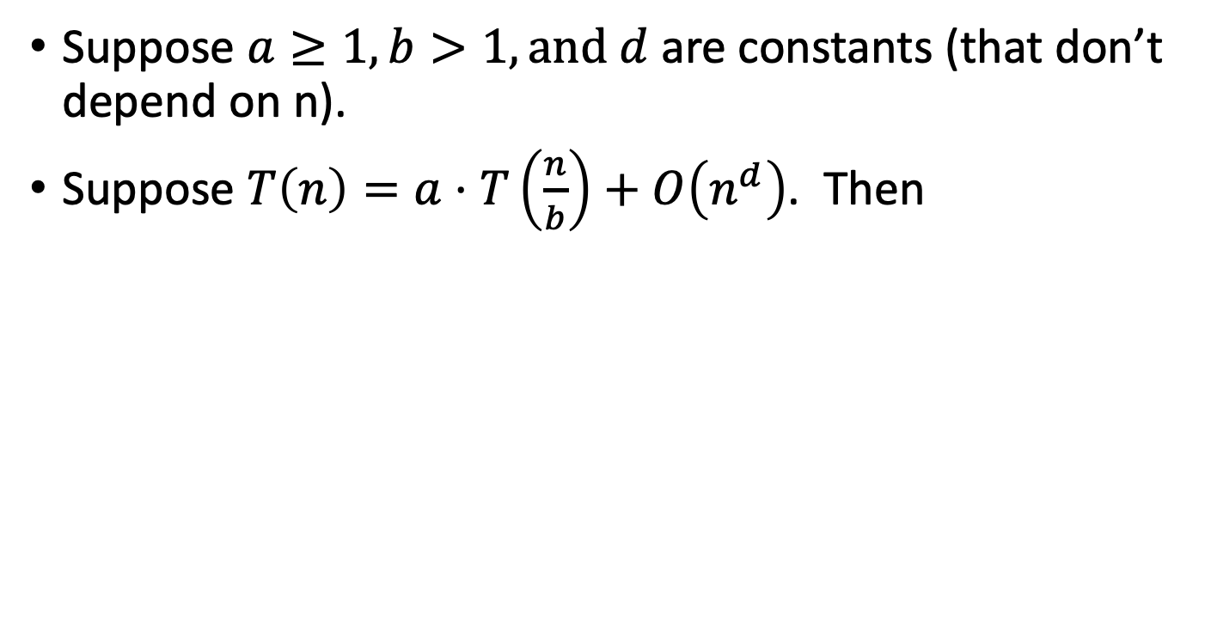
The Master Theorem
Suppose $a≥1,b>1,and d$ are constants (that don’t depend on n).
Suppose $T\left(n\right)=a⋅T\left(\frac{n}{b}\right)+O\left(n^{d}\right)$. Then
Three parameters:
a : number of subproblems
b : factor by which input size shrinks
d : need to do n^{d} work to create all the subproblems and combine their solutions.
A powerful theorem it is…
Jedi master Yoda

Slide 4
The Substitution Method
Step 1: Guess what the answer is.
Step 2: Prove by induction that your guess is correct.
Step 3: Profit.

Slide 5
The plan for today
More practice with the Substitution Method.
k-SELECT problem
k-SELECT solution
Return of the Substitution Method.

Slide 6
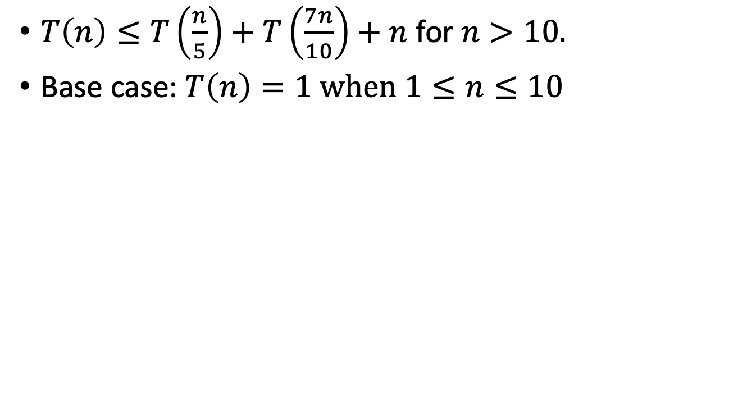
A fun recurrence relation
$T\left(n\right)≤T\left(\frac{n}{5}\right)+T\left(\frac{7n}{10}\right)+n$ for $n>10.$
Base case: $T\left(n\right)=1 when 1≤n≤10$
Apply here, the Master Theorem does NOT.
Jedi master Yoda

Slide 7
What have we learned?
The substitution method can work when the master theorem doesn’t.
For example with different-sized sub-problems.

Slide 8
The Plan
More practice with the Substitution Method.
k-SELECT problem
k-SELECT solution
Return of the Substitution Method.

Slide 9
The k-SELECT problem
For today, assume all arrays have distinct elements.
A is an array of size n, k is in {1,…,n}
SELECT(A, k):
Return the k’th smallest element of A.
7
4
3
8
1
5
9
14
SELECT(A, 1) = 1
SELECT(A, 2) = 3
SELECT(A, 3) = 4
SELECT(A, 8) = 14
SELECT(A, 1) = MIN(A)
SELECT(A, n/2) = MEDIAN(A)
SELECT(A, n) = MAX(A)
Note that the definition of Select is 1-indexed…

Slide 10
An O(nlog(n))-time algorithm
SELECT(A, k):
A = MergeSort(A)
return A[k-1]
Running time is O(n log(n)).
So that’s the benchmark….
Can we do better?
It’s k-1 and not k since my pseudocode is 0-indexed and the problem is 1-indexed…
Show that you can’t do better than O(n).
We’re hoping to get O(n)

Slide 11
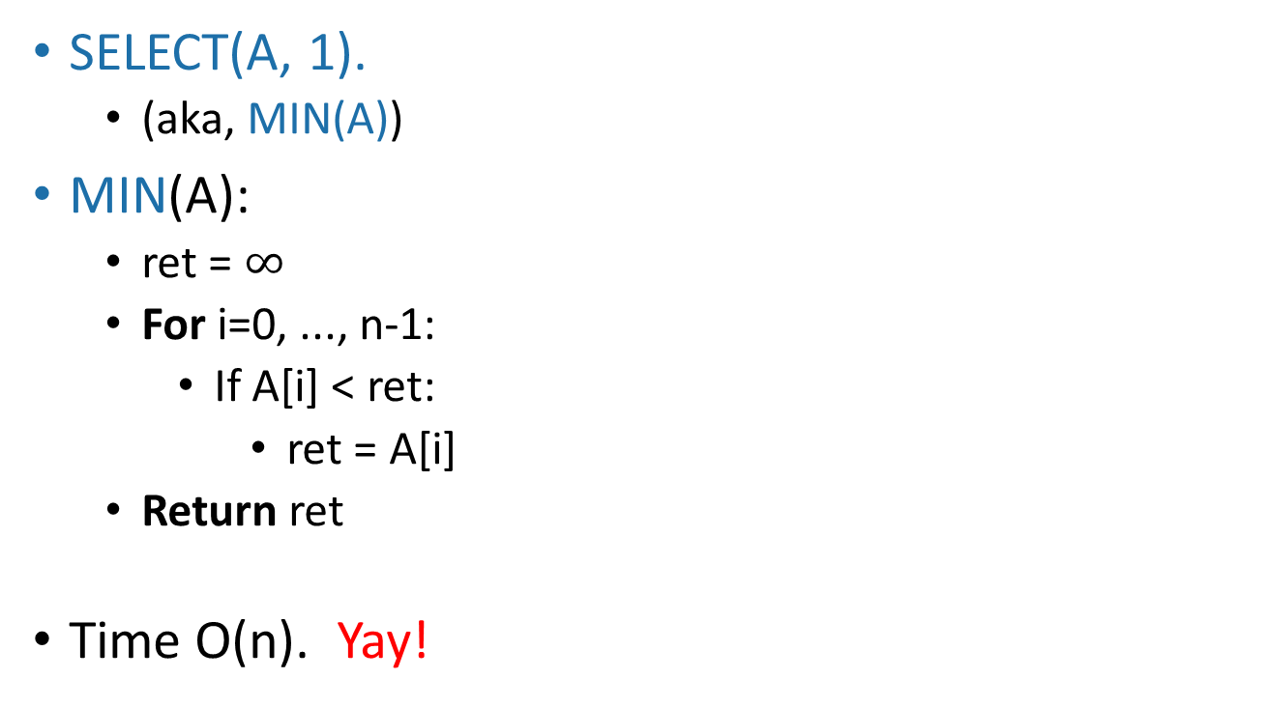
Goal: An O(n)-time algorithm
SELECT(A, 1).
(aka, MIN(A))
MIN(A):
ret = $∞$
For i=0, ..., n-1:
If A[i] < ret:
ret = A[i]
Return ret
Time O(n). Yay!
This loop runs O(n) times
This stuff is O(1)

Slide 12
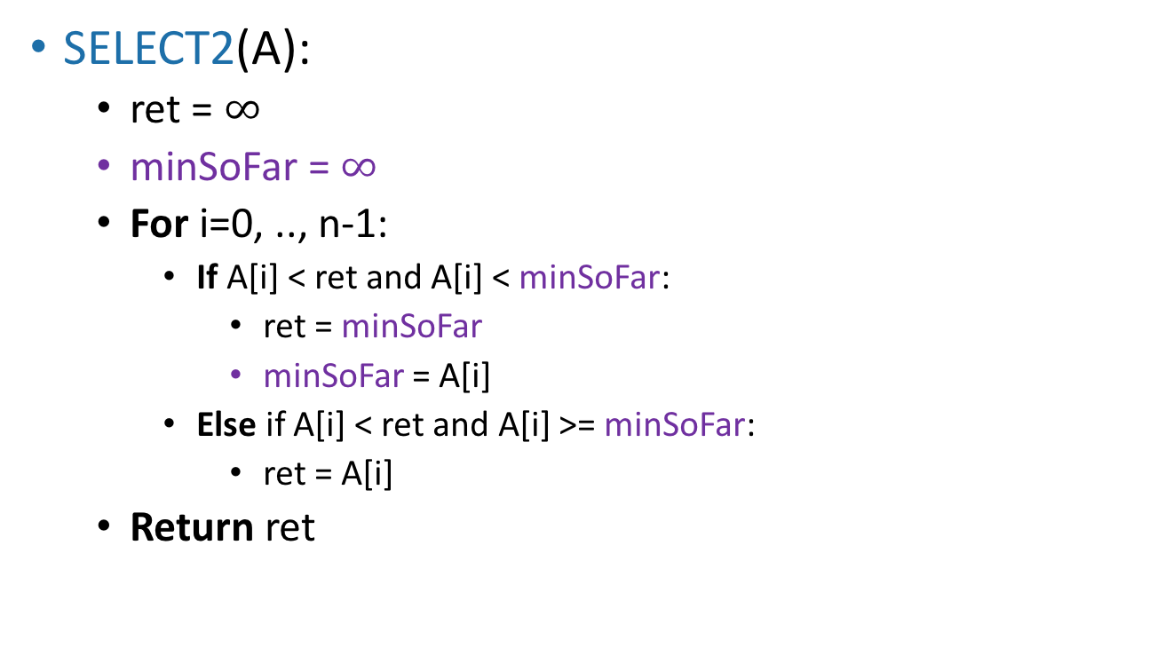
How about SELECT(A,2)?
(The actual algorithm here is not very important because this won’t end up being a very good idea…)
SELECT2(A):
ret = $∞$
minSoFar = $∞$
For i=0, .., n-1:
If A[i] < ret and A[i] < minSoFar:
ret = minSoFar
minSoFar = A[i]
Else if A[i] < ret and A[i] >= minSoFar:
ret = A[i]
Return ret
Still O(n)
SO FAR SO GOOD.

Slide 13
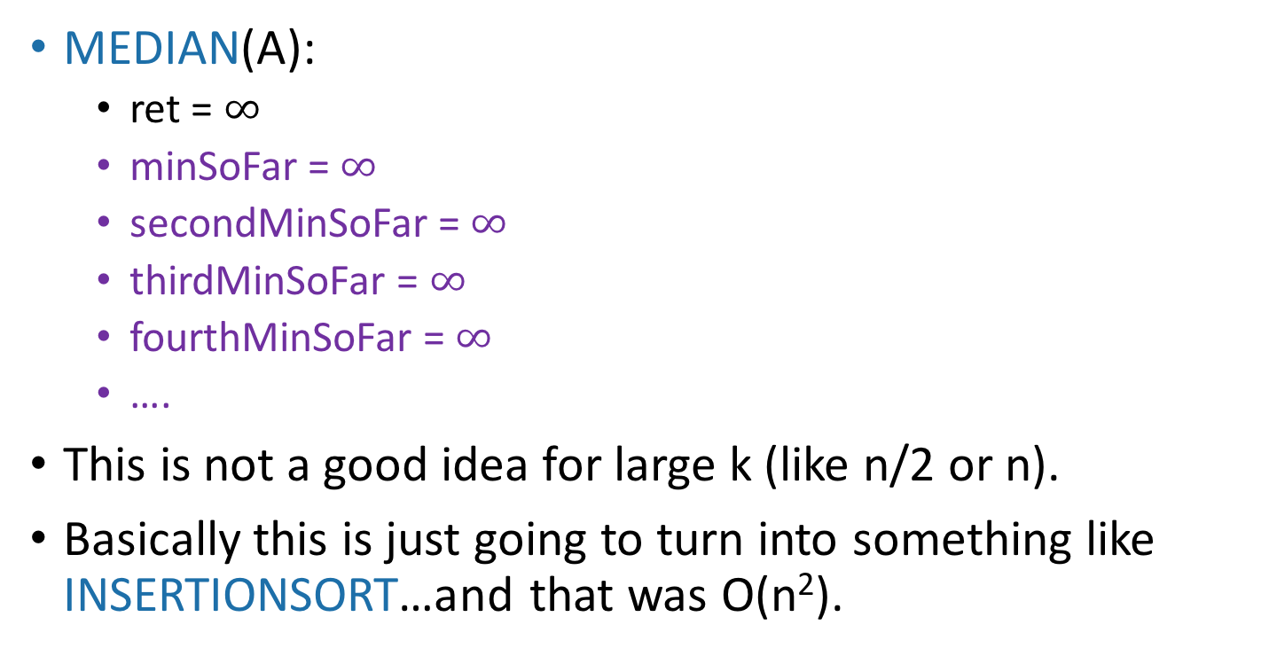
SELECT(A, n/2) aka MEDIAN(A)?
MEDIAN(A):
ret = $∞$
minSoFar = $∞$
secondMinSoFar = $∞$
thirdMinSoFar = $∞$
fourthMinSoFar = $∞$
….
This is not a good idea for large k (like n/2 or n).
Basically this is just going to turn into something like INSERTIONSORT…and that was O(n²).

Slide 14
The Plan
More practice with the Substitution Method.
k-SELECT problem
k-SELECT solution
Return of the Substitution Method.

Slide 15
Idea: divide and conquer!
Say we want to find SELECT(A, k)
9
8
3
6
1
4
2
9
8
3
6
1
4
2
How about this pivot?
First, pick a “pivot.”
We’ll see how to do this later.
This PARTITION step takes time O(n). (Notice that we don’t sort each half).
Next, partition the array into “bigger than 6” or “less than 6”
L = array with things smaller than A[pivot]
R = array with things larger than A[pivot]

Slide 16
Idea: divide and conquer!
Say we want to find SELECT(A, k)
6
6
How about this pivot?
First, pick a “pivot.”
We’ll see how to do this later.
This PARTITION step takes time O(n). (Notice that we don’t sort each half).
Next, partition the array into “bigger than 6” or “less than 6”
3
1
4
2
9
8
L = array with things smaller than A[pivot]
R = array with things larger than A[pivot]

Slide 17
Idea continued…
Say we want to find SELECT(A, k)
6
3
1
4
2
pivot
9
8
L = array with things smaller than A[pivot]
R = array with things larger than A[pivot]
If k = 5 = len(L) + 1:
We should return A[pivot]
If k < 5:
We should return SELECT(L, k)
If k > 5:
We should return SELECT(R, k – 5)
This suggests a recursive algorithm
(still need to figure out how to pick the pivot…)

Slide 18
Pseudocode
getPivot(A)returns some pivot for us.
How?? We’ll see later…
Partition(A,p) splits up A into L, A[p], R.
Select(A,k):
If len(A) <= 50:
A = MergeSort(A)
Return A[k-1]
p = getPivot(A)
L, pivotVal, R = Partition(A,p)
if len(L) == k-1:
return pivotVal
Else if len(L) > k-1:
return Select(L, k)
Else if len(L) < k-1:
return Select(R, k – len(L) – 1)
Base Case: If the len(A) = O(1), then any sorting algorithm runs in time O(1).
Case 1: We got lucky and found exactly the k’th smallest value!
Case 2: The k’th smallest value is in the first part of the list
Case 3: The k’th smallest value is in the second part of the list

Slide 19
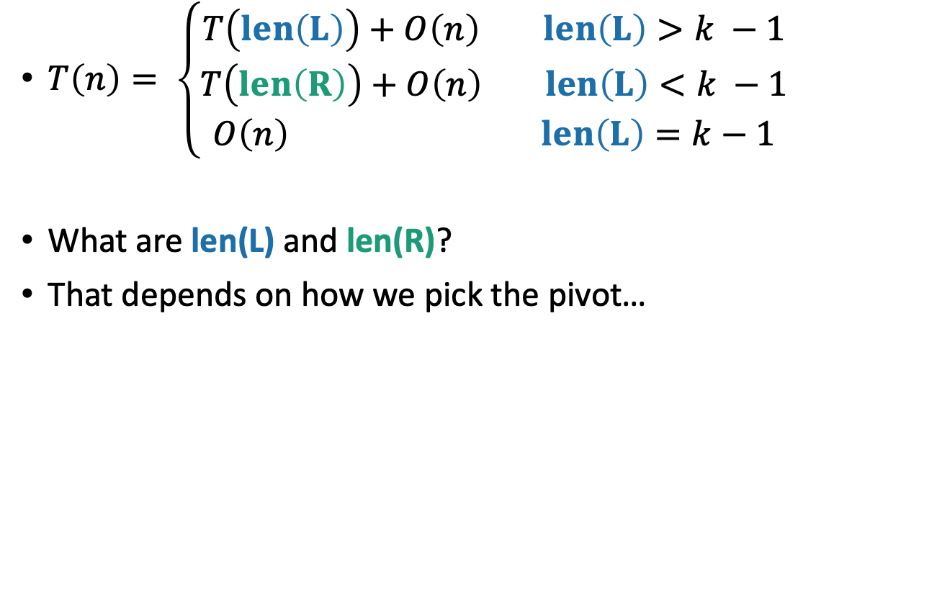
What is the running time? Assuming we pick the pivot in time O(n)…
$T\left(n\right)= \left\{\begin{matrix}T\left(len\left(L\right)\right)+O\left(n\right) len\left(L\right)>k −1 \\ T\left(len\left(R\right)\right)+O\left(n\right) len\left(L\right)<k −1 \\ O\left(n\right) len\left(L\right)=k−1\end{matrix}\right.$
What are len(L) and len(R)?
That depends on how we pick the pivot…
What would be a “good” pivot?
What would be a “bad” pivot?
Think: two minutes
Pair and share: one minute
The best way would be to pick the pivot so that len(L) = k-1. But say we want to pick a pivot in a way that’s good no matter what k is.
Think-Pair-Share Terrapins

Slide 20
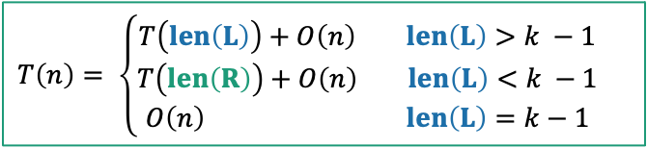
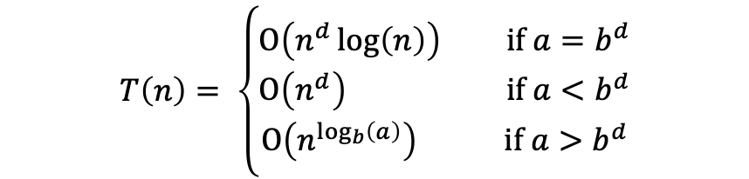
The ideal pivot
We split the input exactly in half:
len(L) = len(R) = (n-1)/2
What would be the running time in that case?
(If we could always choose that ideal pivot)
Think: two minutes
Pair and share: one minute
In case it’s helpful…
Suppose $T\left(n\right)=a⋅T\left(\frac{n}{b}\right)+O\left(n^{d}\right)$. Then
$$T\left(n\right)= \left\{\begin{aligned}O\left(n^{d}\log\left(n\right)\right) if a=b^{d} \\ O\left(n^{d}\right) if a<b^{d} \\ O\left(n^{\log_{b}\left(a\right)}\right) if a>b^{d}\end{aligned}\right.$$
$T\left(n\right)= \left\{\begin{matrix}T\left(len\left(L\right)\right)+O\left(n\right) len\left(L\right)>k −1 \\ T\left(len\left(R\right)\right)+O\left(n\right) len\left(L\right)<k −1 \\ O\left(n\right) len\left(L\right)=k−1\end{matrix}\right.$

Slide 21
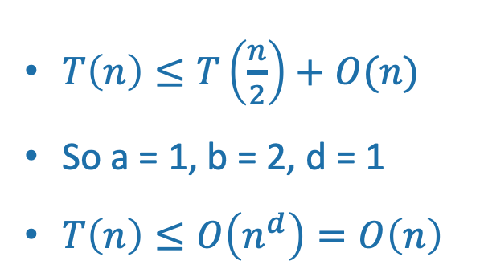
The ideal pivot
Apply here, the Master Theorem does NOT. Making unsubstantiated assumptions about problem sizes, we are.
We split the input exactly in half:
len(L) = len(R) = (n-1)/2
Let’s pretend that’s the case and use the Master Theorem!
$T\left(n\right)≤T\left(\frac{n}{2}\right)+O(n)$
So a = 1, b = 2, d = 1
$T\left(n\right)≤O\left(n^{d}\right)=O\left(n\right)$
Jedi master Yoda
Suppose $T\left(n\right)=a⋅T\left(\frac{n}{b}\right)+O\left(n^{d}\right)$. Then
$$T\left(n\right)= \left\{\begin{aligned}O\left(n^{d}\log\left(n\right)\right) if a=b^{d} \\ O\left(n^{d}\right) if a<b^{d} \\ O\left(n^{\log_{b}\left(a\right)}\right) if a>b^{d}\end{aligned}\right.$$
That would be great!

Slide 22
The worst pivot
Say our choice of pivot doesn’t depend on A.
A bad guy who knows what pivots we will choose gets to come up with A.
2
1
3
pivot

Slide 23
The distinction matters!
For this one I chose the worst possible pivot. Looks like O(n²).
MergeSort-based solution
This one is a random pivot, so it splits the array about in half.
Looks pretty fast!

Slide 24
How do we pick a good pivot?
Randomly?
That works well if there’s no bad guy.
But if there is a bad guy who gets to see our pivot choices, that’s just as bad as the worst-case pivot.
Aside:
In practice, there is often no bad guy. In that case, just pick a random pivot and it works really well!

Slide 25
How do we pick a good pivot?
For today, let’s assume there’s this bad guy.
Reasons:
This gives us a very strong guarantee
We’ll get to see a really clever algorithm.
Necessarily it will look at A to pick the pivot.
We’ll get to use the substitution method.

Slide 26
The Plan
More practice with the Substitution Method.
k-SELECT problem
k-SELECT solution
The outline of the algorithm.
How to pick the pivot.
Return of the Substitution Method.

Slide 27
Approach
First, we’ll figure out what the ideal pivot would be.
But we won’t be able to get it.
Then, we’ll figure out what a pretty good pivot would be.
But we still won’t know how to get it.
Finally, we will see how to get our pretty good pivot!
And then we will celebrate. 🎉

Slide 28
How do we pick our ideal pivot?
We’d like to live in the ideal world.
Pick the pivot to divide the input in half.
Aka, pick the median!
Aka, pick SELECT(A, n/2)!

Slide 29
How about a good enough pivot?
We’d like to approximate the ideal world.
Pick the pivot to divide the input about in half!
Maybe this is easier!

Slide 30
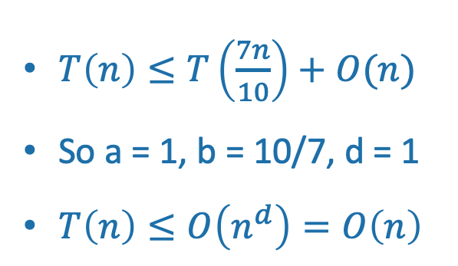
A good enough pivot
We still don’t know that we can get such a pivot, but at least it gives us a goal and a direction to pursue!
We split the input not quite in half:
3n/10 < len(L) < 7n/10
3n/10 < len(R) < 7n/10
If we could do that (let’s say, in time O(n)), the Master Theorem would say:
Lucky the lackadaisical lemur
$T\left(n\right)≤T\left(\frac{7n}{10}\right)+O(n)$
So a = 1, b = 10/7, d = 1
$T\left(n\right)≤O\left(n^{d}\right)=O\left(n\right)$
Suppose $T\left(n\right)=a⋅T\left(\frac{n}{b}\right)+O\left(n^{d}\right)$. Then
STILL GOOD!

Slide 31
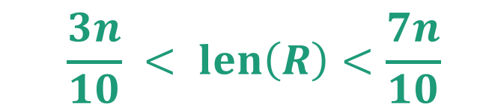
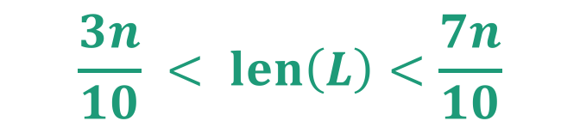
Goal
Efficiently pick the pivot so that
6
3
1
4
2
pivot
9
8
L = array with things smaller than A[pivot]
R = array with things larger than A[pivot]
$$\frac{3n}{10} < len\left(L\right)<\frac{7n}{10}$$
$$\frac{3n}{10} < len\left(R\right)<\frac{7n}{10}$$

Slide 32

Another divide-and-conquer alg!
We can’t solve SELECT(A,n/2) (yet)
But we can divide and conquer and solve SELECT(B,m/2) for smaller values of m (where len(B) = m).
Lemma*: The median of sub-medians is close to the median.
Ideal pivot
What we’ll use as the pivot
median of sub-medians
median of the whole thing
$$≈$$
sub-median
sub-median
sub-median
sub-median
sub-median
*we will make this a bit more precise.

Slide 33
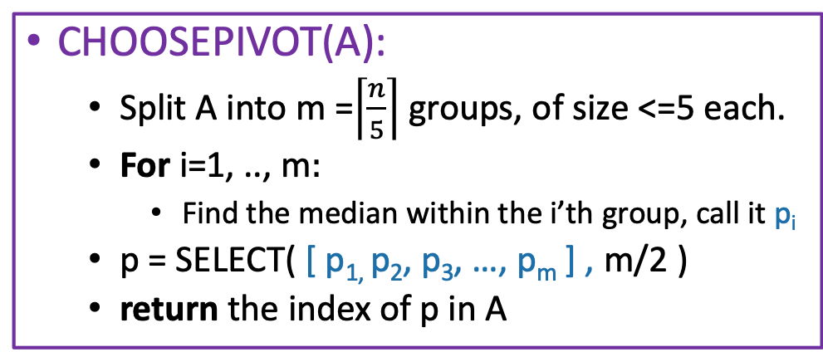
How to pick the pivot
CHOOSEPIVOT(A):
Split A into m =$\left\lceil \frac{n}{5}\right\rceil$ groups, of size <=5 each.
For i=1, .., m$:$
Find the median within the i’th group, call it p_{i}
p = SELECT( [ p_{1,} p₂, p₃, …, p_{m} ] , m/2 )
return the index of p in A
8
This takes time O(1) for each group, since each group has size 5. So that’s O(m)=O(n) total in the for loop.
4
12
2
1
5
20
1
8
9
3
15
5
9
1
3
4
5
15
13
2
4
6
12
1
15
22
3
6
8
4
5
6
12
Pivot is SELECT( , 3 ) = 6:
12
12
2
1
5
20
6
1
8
9
3
15
5
9
1
3
4
15
13
2
4
12
1
15
22
3
PARTITION around that 6:
6
1
3
5
1
3
4
2
1
2
4
1
3
5
8
9
15
9
12
20
15
13
12
15
22
This part is L
This part is R: it’s almost the same size as L.

Slide 34
CLAIM: this works divides the array approximately in half
Empirically

Slide 35
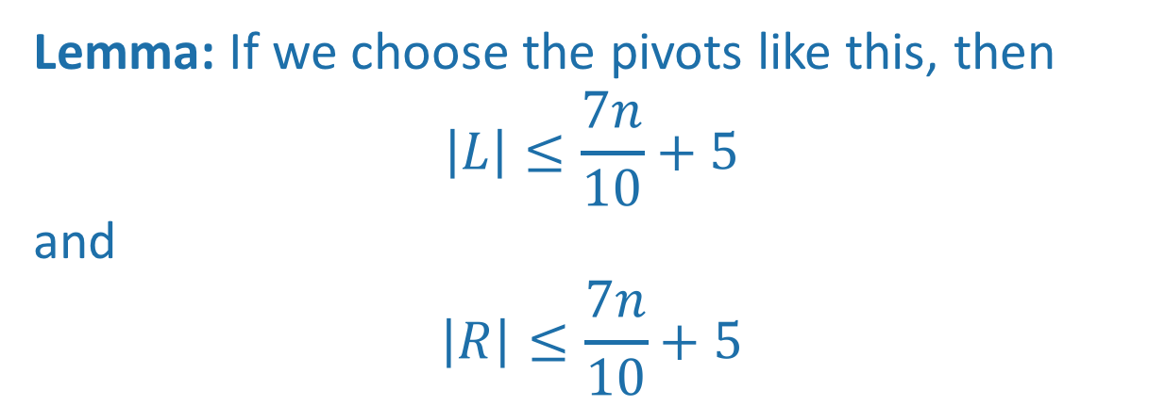
CLAIM: this works divides the array approximately in half
Formally, we will prove (later):
Lemma: If we choose the pivots like this, then
$$\left|L\right|≤\frac{7n}{10}+5$$
and
$$\left|R\right|≤\frac{7n}{10}+5$$

Slide 36
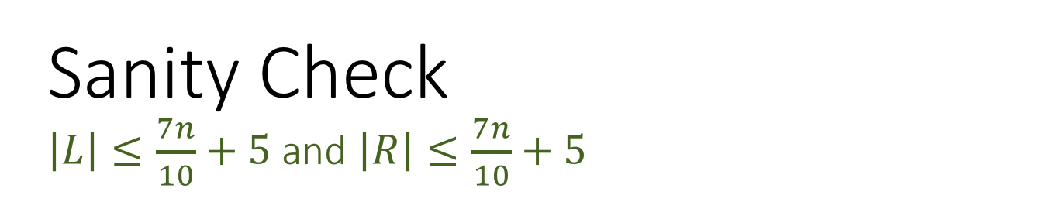
Sanity Check $\left|L\right|≤\frac{7n}{10}+5$and $\left|R\right|≤\frac{7n}{10}+5$
Actually in practice (on randomly chosen arrays) it looks even better!
But this is a worst-case bound.
That’s this window

Slide 37
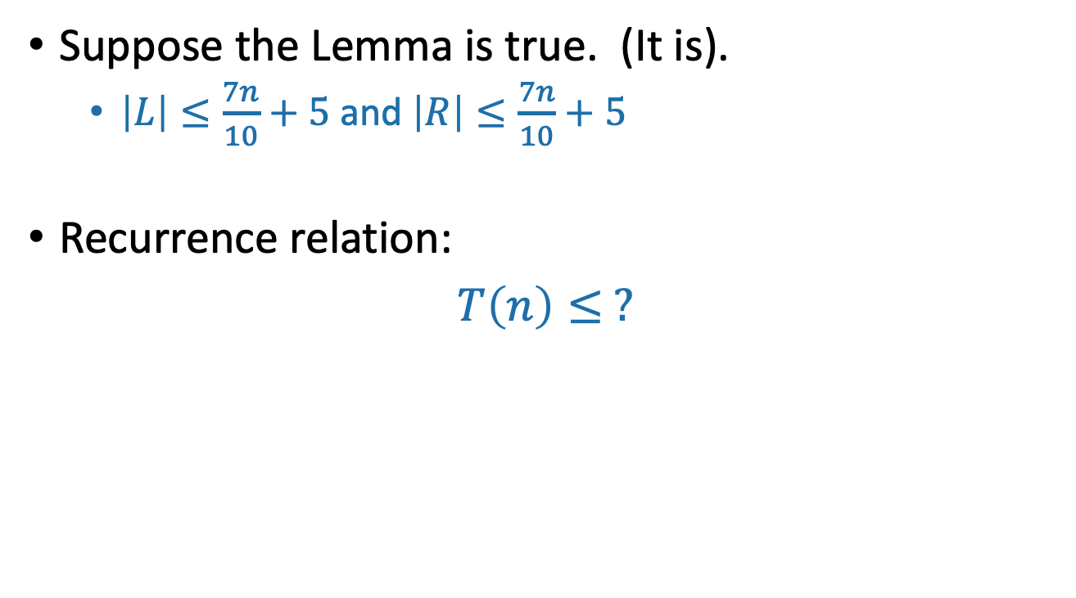
How about the running time?
Suppose the Lemma is true. (It is).
$\left|L\right|≤\frac{7n}{10}+5$and $\left|R\right|≤\frac{7n}{10}+5$
Recurrence relation:
$T\left(n\right)≤ ?$
Think: 2 minutes
Pair and share: 2 minutes

Slide 38
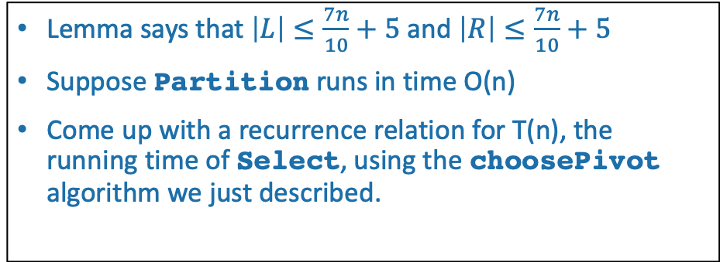
Pseudocode
Lemma says that $\left|L\right|≤\frac{7n}{10}+5$and $\left|R\right|≤\frac{7n}{10}+5$
Suppose Partition runs in time O(n)
Come up with a recurrence relation for T(n), the running time of Select, using the choosePivot algorithm we just described.
Select(A,k):
If len(A) <= 50:
A = MergeSort(A)
Return A[k-1]
p = choosePivot(A)
L, pivotVal, R = Partition(A,p)
if len(L) == k-1:
return pivotVal
Else if len(L) > k-1:
return Select(L, k)
Else if len(L) < k-1:
return Select(R, k – len(L) – 1)
Base Case: If the len(A) = O(1), then any sorting algorithm runs in time O(1).
Case 1: We got lucky and found exactly the k’th smallest value!
Case 2: The k’th smallest value is in the first part of the list
Case 3: The k’th smallest value is in the second part of the list

Slide 39
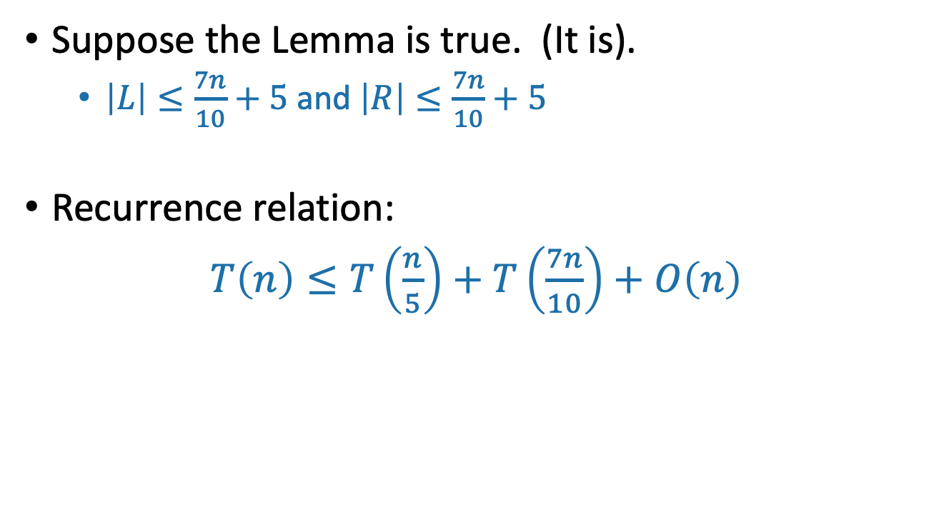
How about the running time?
Suppose the Lemma is true. (It is).
$\left|L\right|≤\frac{7n}{10}+5$and $\left|R\right|≤\frac{7n}{10}+5$
Recurrence relation:
$T\left(n\right)≤T\left(\frac{n}{5}\right)+T\left(\frac{7n}{10}\right)+O\left(n\right)$
The call to CHOOSEPIVOT makes one further recursive call to SELECT on an array of size n/5.
Outside of CHOOSEPIVOT, there’s at most one recursive call to SELECT on array of size 7n/10 + 5.
We’re going to drop the “+5” for convenience, but you can see CLRS for a more careful treatment if you’re curious.

Slide 40
The Plan
More practice with the Substitution Method.
k-SELECT problem
k-SELECT solution
The outline of the algorithm.
How to pick the pivot.
Return of the Substitution Method.

Slide 41
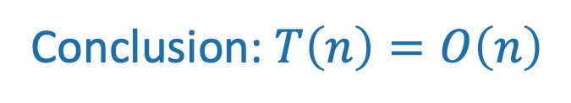
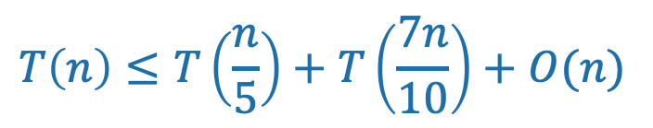
This sounds like a job for…
The Substitution Method!
$$T\left(n\right)≤T\left(\frac{n}{5}\right)+T\left(\frac{7n}{10}\right)+O(n)$$
That’s convenient!
Conclusion: $T\left(n\right)=O\left(n\right)$

Slide 42
Recap of approach
First, we figured out what the ideal pivot would be.
Find the median
Then, we figured out what a pretty good pivot would be.
An approximate median
Finally, we saw how to get our pretty good pivot!
Median of medians and divide and conquer!
Hooray!

Slide 43
In practice?
With my not-very-slick implementation, our fancy version of SELECT is worse than the MergeSort-based SELECT ☹
But O(n) is better than O(nlog(n))! How can that be?
What’s the constant in front of the n in our proof? 20? 30?
On non-adversarial inputs, random pivot choice is much better.
Moral:
Just pick a random pivot if you don’t expect nefarious arrays.
Optimize the implementation of SELECT (with the fancy pivot). Can you beat MergeSort?
Siggi the Studious Stork

Slide 44
What have we learned? Pending the Lemma
It is possible to solve SELECT in time O(n).
Divide and conquer!
If you want a deterministic algorithm expect that a bad guy will be picking the list, choose a pivot cleverly.
More divide and conquer!
If you don’t expect that a bad guy will be picking the list, in practice it’s better just to pick a random pivot.

Slide 45
The Plan
More practice with the Substitution Method.
k-SELECT problem
k-SELECT solution
The outline of the algorithm.
How to pick the pivot.
Return of the Substitution Method.
(Optional) Proof of that Lemma.

Slide 46
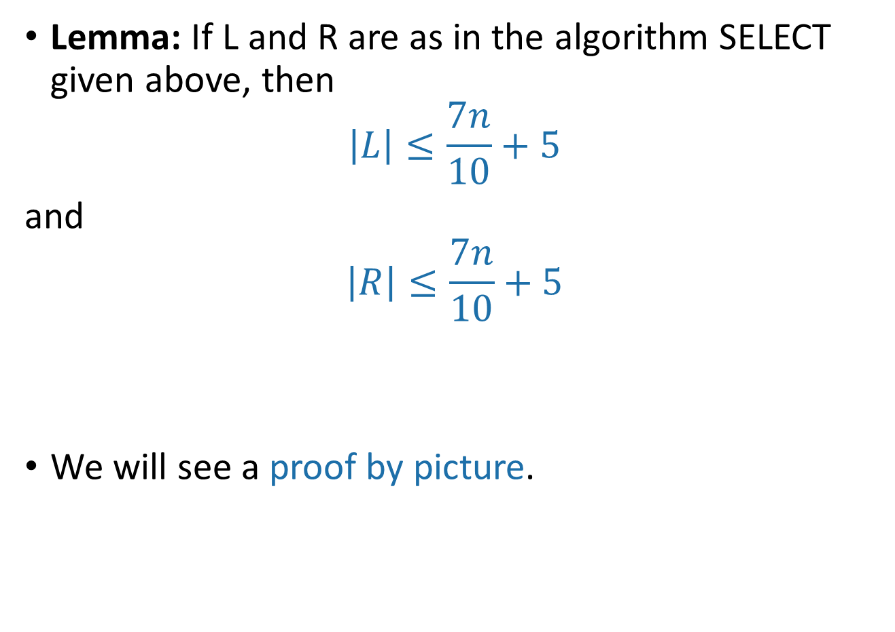
If time, back to the Lemma
Lemma: If L and R are as in the algorithm SELECT given above, then
$$\left|L\right|≤\frac{7n}{10}+5$$
and
$$\left|R\right|≤\frac{7n}{10}+5$$
We will see a proof by picture.

Slide 47
Proof by picture
1
5
2
3
6
8
18
10
13
7
5
9
4
7
70
17
3
6
12
4
22
15
35
11
2
m
Say these are our m = [n/5] sub-arrays of size at most 5.

Slide 48
Proof by picture
1
4
2
2
6
3
5
7
3
7
7
8
6
10
4
5
8
6
10
4
17
9
18
11
13
22
15
35
12
70
m
In our head, let’s sort them.
Then find medians.

Slide 49
Proof by picture
2
4
1
2
3
5
6
3
7
5
4
6
7
8
10
13
18
17
9
11
70
35
22
15
12
m
Then let’s sort them by the median

Slide 50
Proof by picture
2
4
1
2
3
5
6
3
7
5
4
6
7
8
10
13
18
17
9
11
70
35
22
15
12
m
The median of the medians is 7. That’s our pivot!

Slide 51
Proof by picture
We will show that lots of elements are smaller than the pivot, hence not too many are larger than the pivot.
2
4
1
2
3
5
6
3
7
5
4
6
7
8
10
13
18
17
9
11
70
35
22
15
12
m
How many elements are SMALLER than the pivot?

Slide 52
Proof by picture
2
4
1
2
3
5
6
3
7
5
4
6
7
8
10
13
18
17
9
11
70
35
22
15
12
m
At least these ones: everything above and to the left.

Slide 53
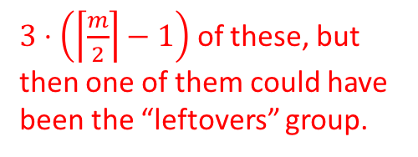
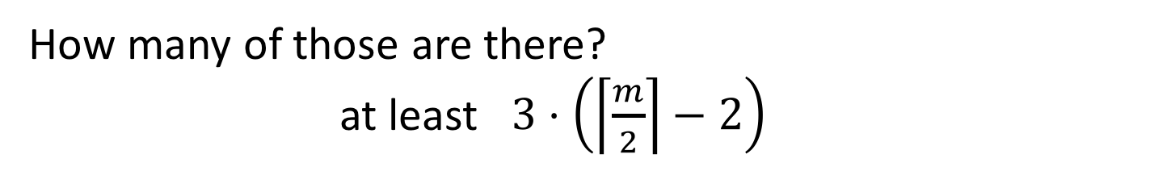
Proof by picture
$3⋅\left(\left\lceil \frac{m}{2}\right\rceil −1\right)$ of these, but then one of them could have been the “leftovers” group.
2
4
1
2
3
5
6
3
7
5
4
6
7
8
10
13
18
17
9
11
70
35
22
15
12
m
How many of those are there?
at least $3⋅\left(\left\lceil \frac{m}{2}\right\rceil −2\right)$

Slide 54
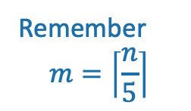

Proof by picture
2
4
1
2
3
5
6
3
7
5
4
6
7
8
10
13
18
17
9
11
70
35
22
15
12
m
So how many are LARGER than the pivot? At most…
$$n −1 −3\left(\left\lceil \frac{m}{2}\right\rceil −2\right)≤\frac{7n}{10}+5$$
Remember
$$m=\left\lceil \frac{n}{5}\right\rceil$$

Slide 55
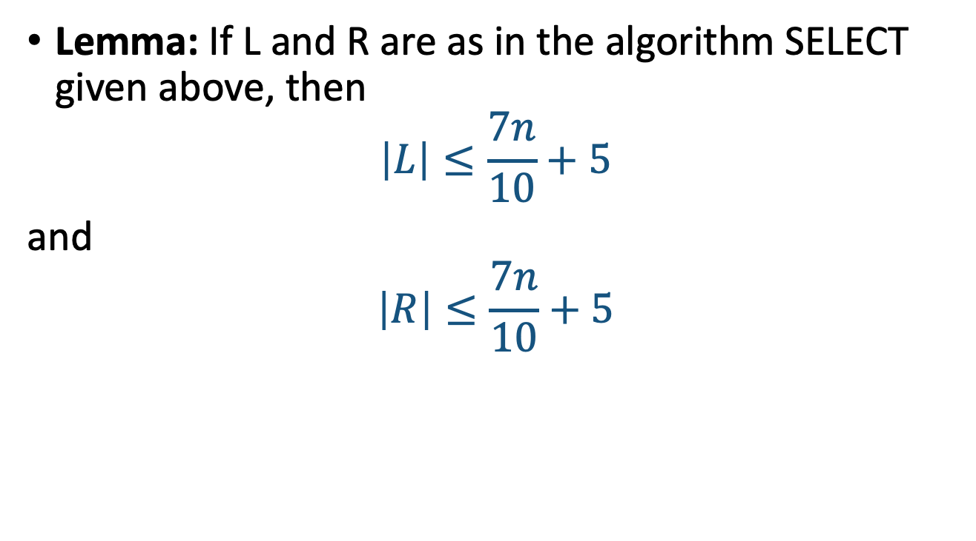
That was one part of the lemma
Lemma: If L and R are as in the algorithm SELECT given above, then
$$\left|L\right|≤\frac{7n}{10}+5$$
and
$$\left|R\right|≤\frac{7n}{10}+5$$
The other part is exactly the same.

Slide 56
The Plan
More practice with the Substitution Method.
k-SELECT problem
k-SELECT solution
The outline of the algorithm.
How to pick the pivot.
Return of the Substitution Method.
(If time) Proof of that Lemma.
Recap

Slide 57
Recap
Substitution method can work when the master theorem doesn’t.
One place we needed it was for SELECT.
Which we can do in time O(n)!

Slide 58
Next time
QuickSort!

Slide 59
Lecture
QuickSort

Slide 60
Last time
We saw a divide-and-conquer algorithm to solve the Select problem in time O(n) in the worst-case.
It all came down to picking the pivot…
We choose a pivot cleverly
We choose a pivot randomly.

Slide 61
Randomized algorithms
We make some random choices during the algorithm.
We hope the algorithm works.
We hope the algorithm is fast.
For today we will look at algorithms that always work and are probably fast.
e.g., Select with a random pivot is a randomized algorithm.
Always works (aka, is correct).
Probably fast.

Slide 62
Today
How do we analyze randomized algorithms?
A few randomized algorithms for sorting.
BogoSort
QuickSort
BogoSort is a pedagogical tool.
QuickSort is important to know. (in contrast with BogoSort…)

Slide 63
Today
How do we analyze randomized algorithms?
A few randomized algorithms for sorting.
BogoSort
QuickSort
BogoSort is a pedagogical tool.
QuickSort is important to know. (in contrast with BogoSort…)

Slide 64
a better randomized algorithm: QuickSort
Expected runtime O(nlog(n)).
Worst-case runtime O(n²).
In practice works great!

Slide 65
Quicksort
For the rest of the lecture, assume all elements of A are distinct.
We want to sort this array.
First, pick a “pivot.”
Do it at random.
7
6
3
5
1
2
4
7
6
3
5
1
2
4
This PARTITION step takes time O(n). (Notice that we don’t sort each half).
[same as in SELECT]
Next, partition the array into “bigger than 5” or “less than 5”
random pivot!
Arrange them like so:
L = array with things smaller than A[pivot]
R = array with things larger than A[pivot]
Recurse on
L and R:
1
2
3
4
5
6
7

Slide 66
PseudoPseudoCode for what we just saw
QuickSort(A):
If len(A) <= 1:
return
Pick some x = A[i] at random. Call this the pivot.
PARTITION the rest of A into:
L (less than x) and
R (greater than x)
Replace A with [L, x, R] (that is, rearrange A in this order)
QuickSort(L)
QuickSort(R)
Assume that all elements of A are distinct. How would you change this if that’s not the case?

Slide 67

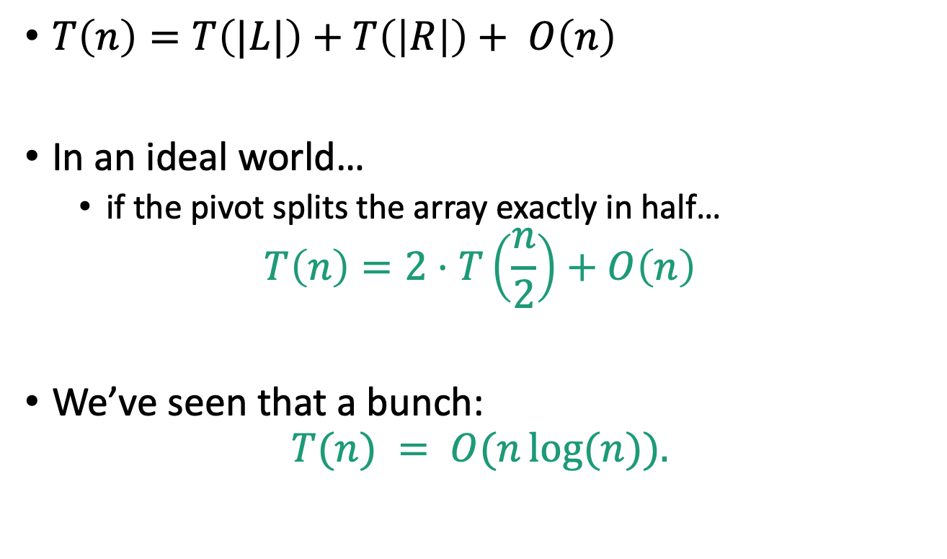
Running time?
$T\left(n\right)=T\left(|L|\right)+T\left(\left|R\right|\right)+ O\left(n\right)$
In an ideal world…
if the pivot splits the array exactly in half…
$$T\left(n\right)=2⋅T\left(\frac{n}{2}\right)+O\left(n\right)$$
We’ve seen that a bunch:
$$T(n) = O(n\log{(n)}).$$

Slide 68
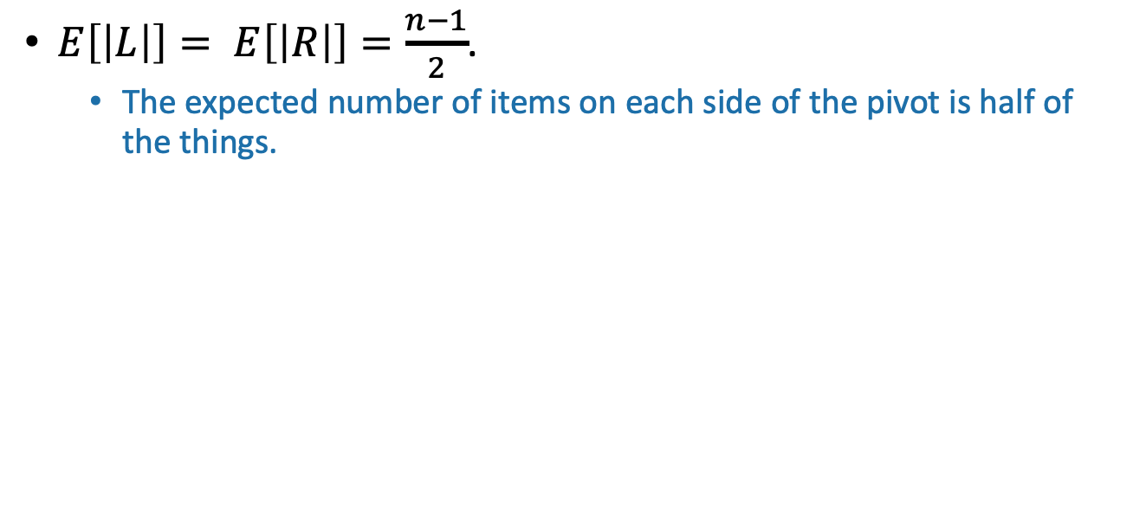
The expected running time of QuickSort is O(nlog(n)).
*
Proof:
$E\left[\left|L\right|\right]= E\left[\left|R\right|\right]=\frac{n−1}{2}$.
The expected number of items on each side of the pivot is half of the things.

Slide 69
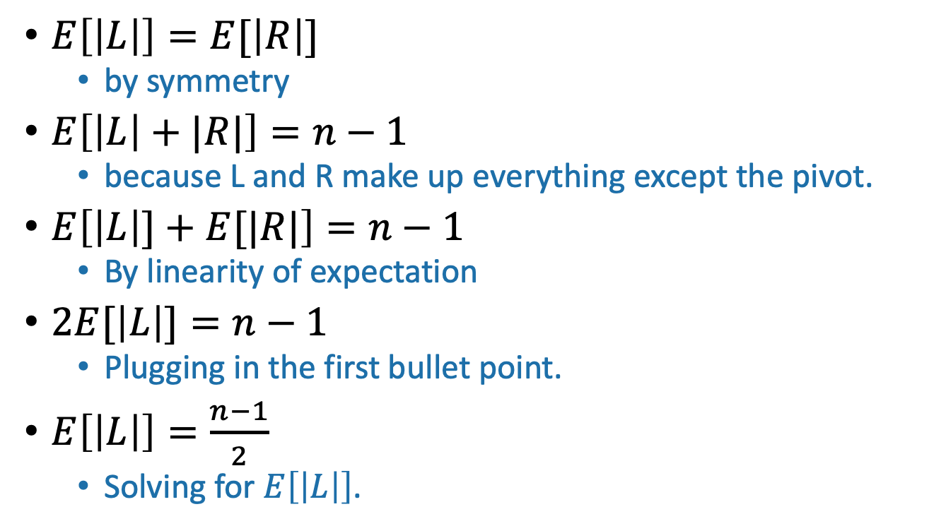
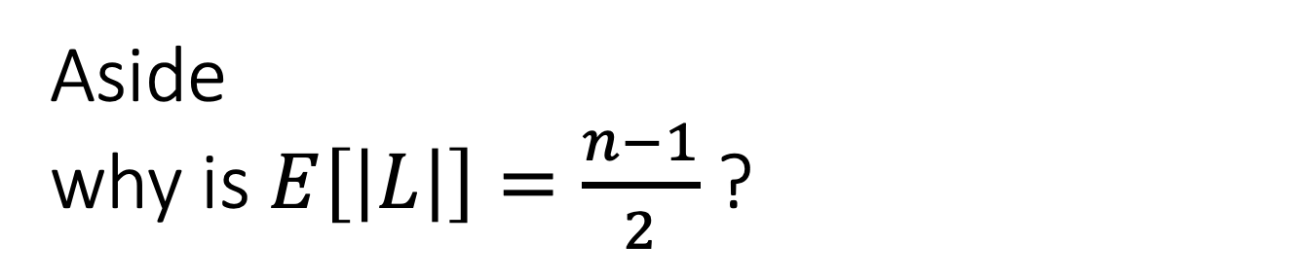
Aside why is $E\left[\left|L\right|\right]=\frac{n−1}{2}$?
Remember, we are assuming all elements of A are distinct
$E\left[\left|L\right|\right]=E[\left|R\right|]$
by symmetry
$E\left[\left|L\right|+|R|\right]=n−1$
because L and R make up everything except the pivot.
$E\left[\left|L\right|]+E[|R|\right]=n−1$
By linearity of expectation
$2E[\left|L\right|]=n−1$
Plugging in the first bullet point.
$E\left[\left|L\right|\right]=\frac{n−1}{2}$
Solving for $E\left[\left|L\right|\right]$.

Slide 70
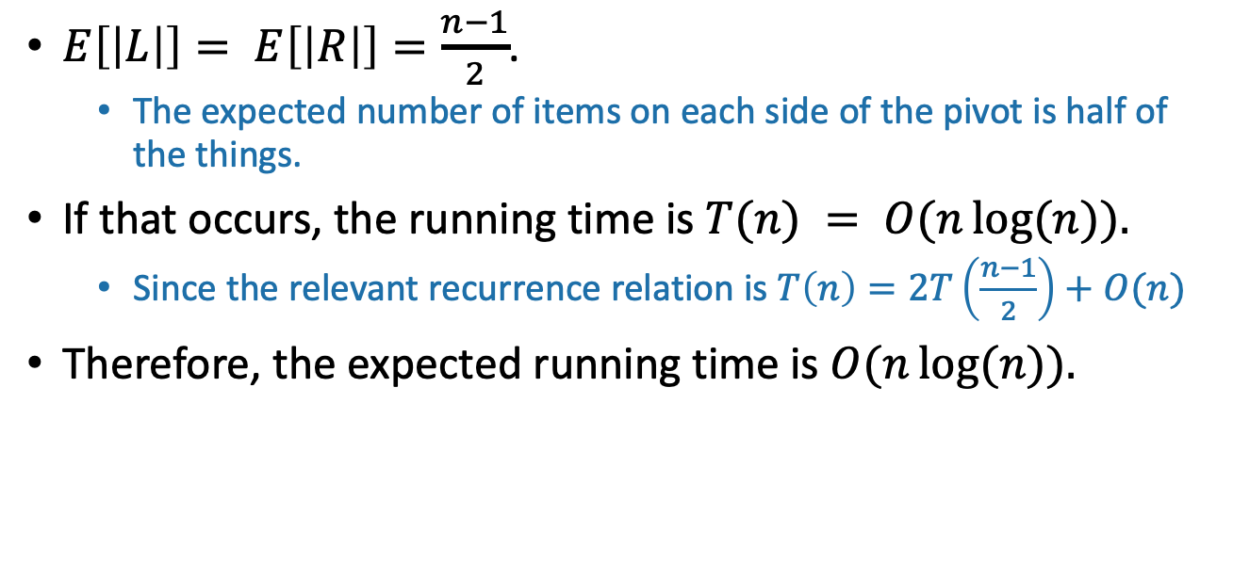
The expected running time of QuickSort is O(nlog(n)).
*
Proof:
$E\left[\left|L\right|\right]= E\left[\left|R\right|\right]=\frac{n−1}{2}$.
The expected number of items on each side of the pivot is half of the things.
If that occurs, the running time is $T(n) = O(n\log{(n)}).$
Since the relevant recurrence relation is $T\left(n\right)=2T\left(\frac{n−1}{2}\right)+O(n)$
Therefore, the expected running time is $O(n\log{(n)}).$
*Disclaimer: this proof is wrong.

Slide 71
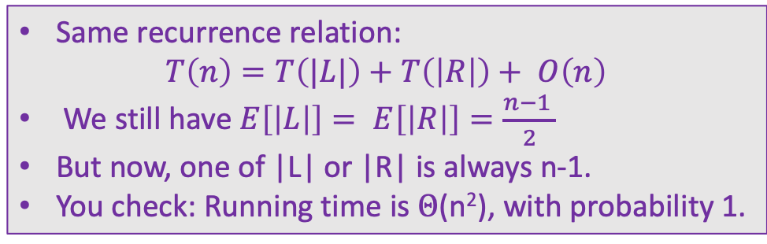
Red flag
Slow
QuickSort(A):
If len(A) <= 1:
return
Pick some x = A[i] at random. Call this the pivot.
PARTITION the rest of A into:
L (less than x) and
R (greater than x)
Replace A with [L, x, R] (that is, rearrange A in this order)
QuickSort(L)
QuickSort(R)
We can use the same argument to prove something false.
Pick the pivot x to be either max(A) or min(A), randomly
\\ We can find the max and min in O(n) time
Slow
Same recurrence relation:
$$T\left(n\right)=T\left(|L|\right)+T\left(\left|R\right|\right)+ O\left(n\right)$$
We still have $E\left[\left|L\right|\right]= E\left[\left|R\right|\right]=\frac{n−1 }{2}$
But now, one of |L| or |R| is always n-1.
You check: Running time is $Θ$(n²), with probability 1.
Slow

Slide 72
The expected running time of SlowSort is O(nlog(n)).
What’s wrong???
2 minutes: think
1 minute: pair and share
*
Proof:
$E\left[\left|L\right|\right]= E\left[\left|R\right|\right]=\frac{n−1}{2}$.
The expected number of items on each side of the pivot is half of the things.
If that occurs, the running time is $T(n) = O(n\log{(n)}).$
Since the relevant recurrence relation is $T\left(n\right)=2T\left(\frac{n−1}{2}\right)+O(n)$
Therefore, the expected running time is $O(n\log{(n)}).$
*Disclaimer: this proof is wrong.

Slide 73
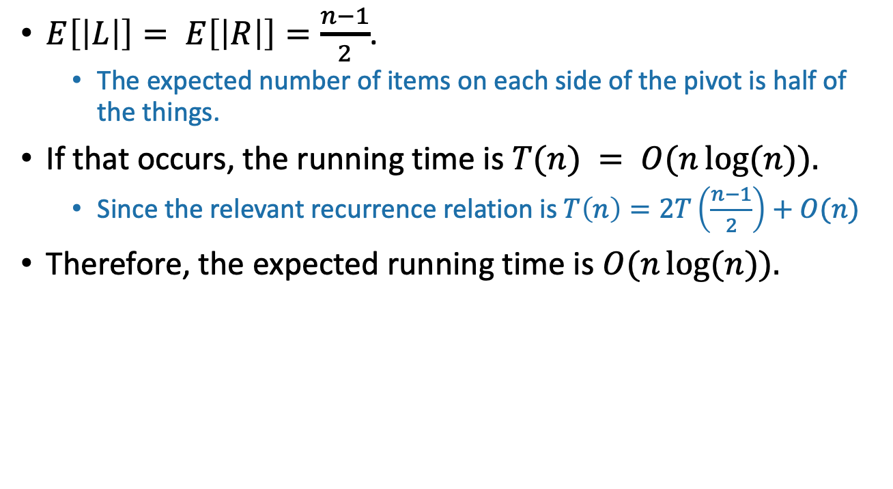
What’s wrong?
$E\left[\left|L\right|\right]= E\left[\left|R\right|\right]=\frac{n−1}{2}$.
The expected number of items on each side of the pivot is half of the things.
If that occurs, the running time is $T(n) = O(n\log{(n)}).$
Since the relevant recurrence relation is $T\left(n\right)=2T\left(\frac{n−1}{2}\right)+O(n)$
Therefore, the expected running time is $O(n\log{(n)}).$
That’s not how expectations work!
The running time in the “expected” situation is not the same as the expected running time.
Sort of like how E[X²] is not the same as (E[X])²
Plucky the Pedantic Penguin

Slide 74
What have we learned?
The expected running time of QuickSort is O(nlog(n))

Slide 75
Worst-case running time
Suppose that an adversary is choosing the “random” pivots for you.
Then the running time might be O(n²)
Eg, they’d choose to implement SlowSort
In practice, this doesn’t usually happen.

Slide 76
How should we implement this?
Our pseudocode is easy to understand and analyze, but is not a good way to implement this algorithm.
Instead, implement it in-place (without separate L and R)
QuickSort(A):
If len(A) <= 1:
return
Pick some x = A[i] at random. Call this the pivot.
PARTITION the rest of A into:
L (less than x) and
R (greater than x)
Replace A with [L, x, R] (that is, rearrange A in this order)
QuickSort(L)
QuickSort(R)

Slide 77
A better way to do Partition
Pivot
8
7
1
3
5
6
4
Choose it randomly, then swap it with the last one, so it’s at the end.
8
7
1
3
5
6
4
Initialize and
Swap!
Step forward.
1
7
8
3
5
6
4
When sees something smaller than the pivot, swap the things ahead of the bars and increment both bars.
1
3
8
7
5
6
4
1
3
8
7
5
6
4
Repeat till the end, then put the pivot in the right place.
1
3
4
7
5
6
8

Slide 78
QuickSort vs MergeSort
*What if you want O(nlog(n)) worst-case runtime and stability? Check out “Block Sort” on Wikipedia!
 | QuickSort (random pivot) | MergeSort (deterministic)
Running time | Worst-case: O(n²) Expected: O(n log(n)) | Worst-case: O(n log(n))
Used by | Java for primitive types C qsort Unix g++ | Java for objects Perl
In-Place? (With O(log(n)) extra memory) | Yes, pretty easily | Not easily* if you want to maintain both stability and runtime. (But pretty easily if you can sacrifice runtime).
Stable? | No | Yes
Other Pros | Good cache locality if implemented for arrays | Merge step is really efficient with linked lists
Understand this
These are just for fun. (Not on exam).

Slide 79
Today
How do we analyze randomized algorithms?
A few randomized algorithms for sorting.
BogoSort
QuickSort
BogoSort is a pedagogical tool.
QuickSort is important to know. (in contrast with BogoSort…)
Recap

Slide 80
Recap
How do we measure the runtime of a randomized algorithm?
Expected runtime
Worst-case runtime
QuickSort (with a random pivot) is a randomized sorting algorithm.
In many situations, QuickSort is nicer than MergeSort.
In many situations, MergeSort is nicer than QuickSort.
Code up QuickSort and MergeSort in a few different languages, with a few different implementations of lists A (array vs linked list, etc). What’s faster?
(This is an exercise best done in C where you have a bit more control than in Python).
Ollie the over-achieving ostrich

